Slide 1
Reactive Programming Reactive Streams
James.Fennell@lit.ie

Slide 2
Reactive Streams
What are reactive streams and how do they work
Reactive Streams – the concept
The Scope of Reactive Streams
The Reactive Streams API

Slide 3
Reactive Streams
An effort to standardise the way we build asynchronous stream processing with non-blocking back pressure
Specific focus on runtime environments (JVM and JavaScript) as well as Network protocols
https://www.reactive-streams.org/
Started in 2013 by engineers in Netflix, Pivotal, and Typesafe

Slide 4
Reactive Streams What is it fixing?
Handling Streams of data requires a lot of design and thought in an asynchronous system
Particularly live data with unpredictable volume
They needed to find a solution to back pressure
The idea was to create a standard template for these systems to operate by
standardisation means more people understand the architecture quickly
more applications can interact with your system

Slide 5
Reactive Streams Scope for the solution
Find a clean simple set of interfaces, methods and protocols
describe the software operations and entities that will achieve the Reactive Streams goal
It should not be reliant on specific languages or restrictive APIs
This should encourage a wide adoption of the solution
Define a model for backpressure
Ensure the publisher does not overwhelm the subscriber

Slide 6
Reactive Streams Scope for the solution
Find a clean simple set of interfaces, methods and protocols
Publisher<T> : A producer of items of type T (and related control messages) received by Subscribers
Subscriber<T> : A receiver of messages of type T
Processor<T,R> : A component that acts as both a Subscriber and Publisher of items of type T
Subscription : Message control linking a Publisher and Subscriber

Slide 7
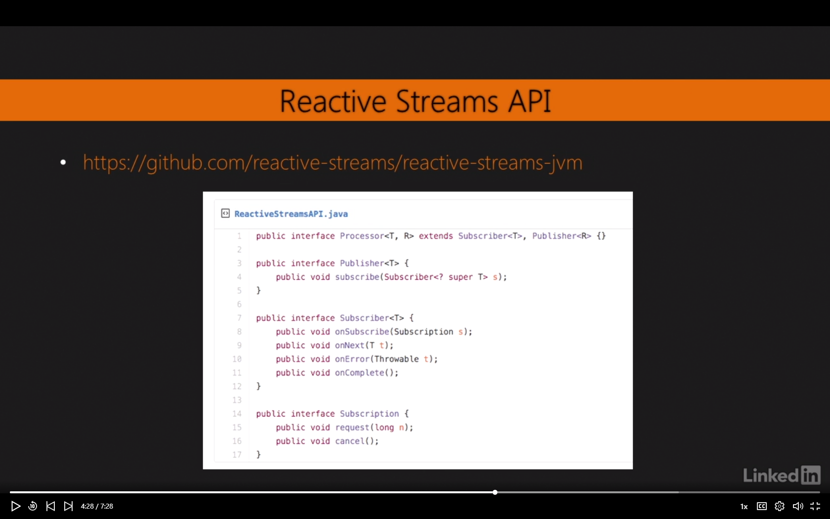
Reactive Streams Implementation of the solution
Here are the interfaces for reactive streams on the jvm
You can see the project here
https://github.com/reactive-streams/reactive-streams-jvm

Slide 8
Reactive Streams Key Rules for Implementation
If a publisher fails it must signal an onError
When a publisher successfully terminates it must signal an onComplete
If a subscription is cancelled the subscriber must eventually stop being signalled
Publisher.subscribe must be called by a different subscriber each time
each subscriber can only have one subscription
A subscriber must signal demand by Subscription.request(long n) to receive inNext signals
https://github.com/reactive-streams/reactive-streams-jvm/blob/v1.0.3/README.md

Slide 9
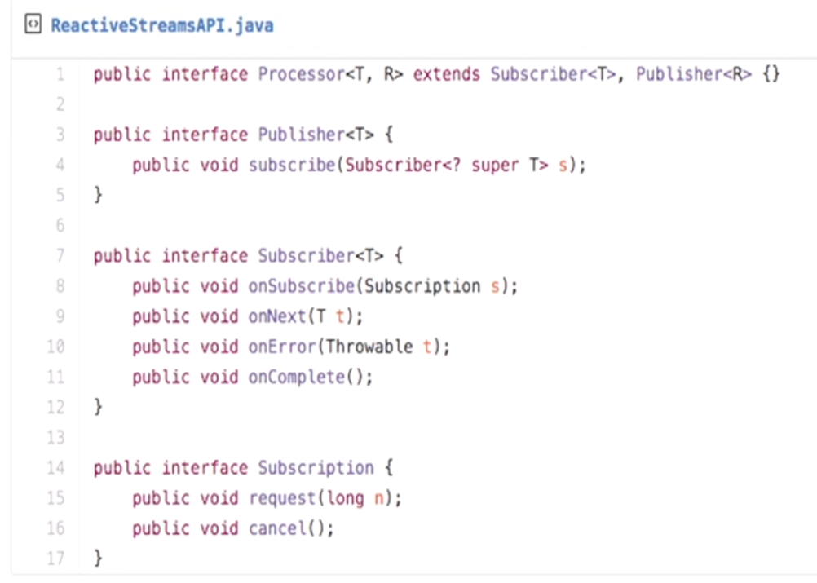
Reactive Streams Publisher Interface
The total number of onNext´s signalled by a Publisher to a Subscriber MUST be less than or equal to the total number of elements requested by that Subscriber´s Subscription at all times.
A Publisher MAY signal fewer onNext than requested and terminate the Subscription by calling onComplete or onError.
onSubscribe, onNext, onError and onComplete signalled to a Subscriber MUST be signalled serially
If a Publisher fails it MUST signal an onError

Slide 10
Reactive Streams Publisher Interface
If a Publisher terminates successfully (finite stream) it MUST signal an onComplete
If a Publisher signals either onError or onComplete on a Subscriber, that Subscriber’s Subscription MUST be considered cancelled
Once a terminal state has been signaled (onError, onComplete) it is REQUIRED that no further signals occur
If a Subscription is cancelled its Subscriber MUST eventually stop being signaled

Slide 11
Reactive Streams Publisher Interface
If a Publisher terminates successfully (finite stream) it MUST signal an onComplete
If a Publisher signals either onError or onComplete on a Subscriber, that Subscriber’s Subscription MUST be considered cancelled
Once a terminal state has been signaled (onError, onComplete) it is REQUIRED that no further signals occur
If a Subscription is cancelled its Subscriber MUST eventually stop being signalled

Slide 12
Reactive Streams Publisher Interface
Publisher.subscribe MUST call onSubscribe on the provided Subscriber prior to any other signals to that Subscriber and MUST return normally,the only legal way to signal failure (or reject the Subscriber) is by calling onError (after calling onSubscribe)
except when the provided Subscriber is null in which case it MUST throw a java.lang.NullPointerException to the caller
Publisher.subscribe MAY be called as many times as wanted but MUST be with a different Subscriber each time
A Publisher MAY support multiple Subscribers and decides whether each Subscription is unicast or multicast.

Slide 13
Reactive Streams Publisher Interface
If at all possible the general rule is:
Don’t write your own Publisher
Java provides some useful implementations of the publisher - SubmissionPublisher

Slide 14
Reactive Streams Subscriber Interface
A Subscriber MUST signal demand via Subscription.request(long n) to receive onNext signals
If a Subscriber suspects that its processing of signals will negatively impact its Publisher´s responsivity, it is RECOMMENDED that it asynchronously dispatches its signals
the Subscriber should not starve the Publisher from receiving CPU cycles
Subscriber.onComplete() and Subscriber.onError(Throwable t) MUST NOT call any methods on the Subscription or the Publisher

Slide 15
Reactive Streams Subscriber Interface
Subscriber.onComplete() and Subscriber.onError(Throwable t) MUST consider the Subscription cancelled after having received the signal
A Subscriber MUST call Subscription.cancel() on the given Subscription after an onSubscribe signal if it already has an active Subscription
A Subscriber MUST call Subscription.cancel() if the Subscription is no longer needed

Slide 16
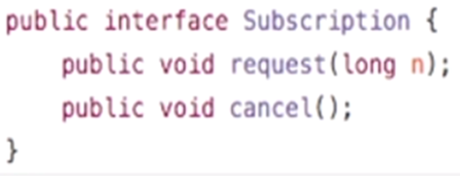
Reactive Streams Subscriber Interface
Similar set of rules for the Subscriber and Subscription that enforce the logic described for the publisher
https://github.com/reactive-streams/reactive-streams-jvm/blob/v1.0.3/README.md#2-subscriber-code
https://github.com/reactive-streams/reactive-streams-jvm/blob/v1.0.3/README.md#3-subscription-code
The Processor applies rules for both Publisher and Subscriber but includes the potential for more complexity than just transformations
https://github.com/reactive-streams/reactive-streams-jvm/blob/v1.0.3/README.md#4processor-code

Slide 17
Implement a pubSub using Reactive Streams implementation
Notes:
https://www.youtube.com/watch?v=dwP1TNXE6fc

